Slide 1
Sounds
October 23
We’re leveling up today, please download Brackets
https://brackets.io/

Slide 2
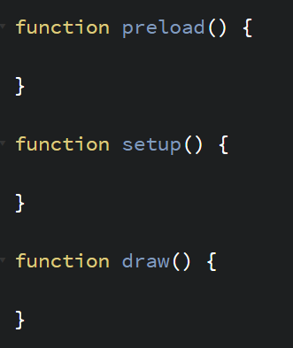
p5.js Preload
p5 doesn’t run until everything here has been loaded.
Runs after preload and before draw.
Run after setup. Repeats over and over forever.

Slide 3
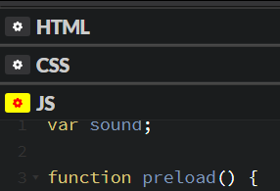
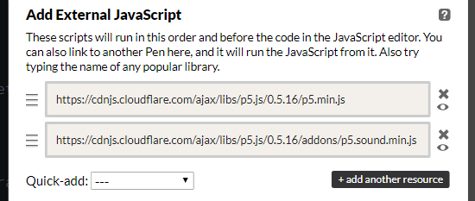
p5.js Sound Library
Sound is a p5.js addon, so we have to include it in our project.
Sound Template: https://cdpn.io/e/NaJwgB
https://cdnjs.com/libraries/p5.js

Slide 4
https://cdpn.io/e/NaJwgB
p5.js sound template

Slide 5
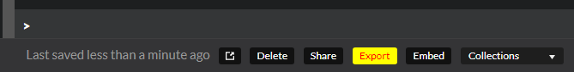
Sound Hosting…
… doesn’t exist. ☹
So we’re going local!
Export your midterm (or the template)
Open up Brackets now!

Slide 6
Brackets
PROS
CONS
All the images/media you want
Customizable
Extendable
Not as error friendly
Have to zip up files to send

Slide 7
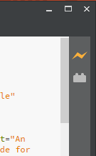
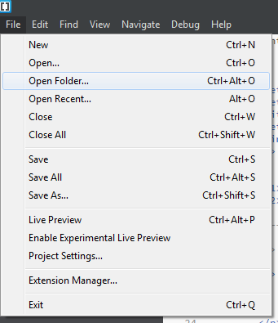
Brackets

Slide 8
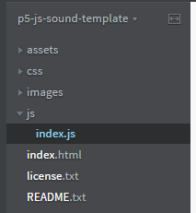
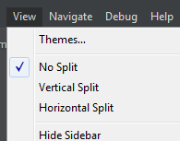
Brackets

Slide 9

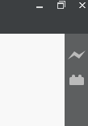
Brackets

Slide 10
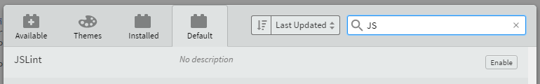
Bracket Error Removal

Slide 11
SoundFile
sound = loadSound(“assets/sound.mp3”);
sound.play();
sound.loop(); // play over and over
sound.stop();
sound.isPlaying() // use with if
sound.setVolume(0.0 to 1.0);
sound.playMode(“restart” or “sustain”);
Start at the beginning every time
Continue playing as normal
What happens when you play a file that’s already playing

